Slide 1

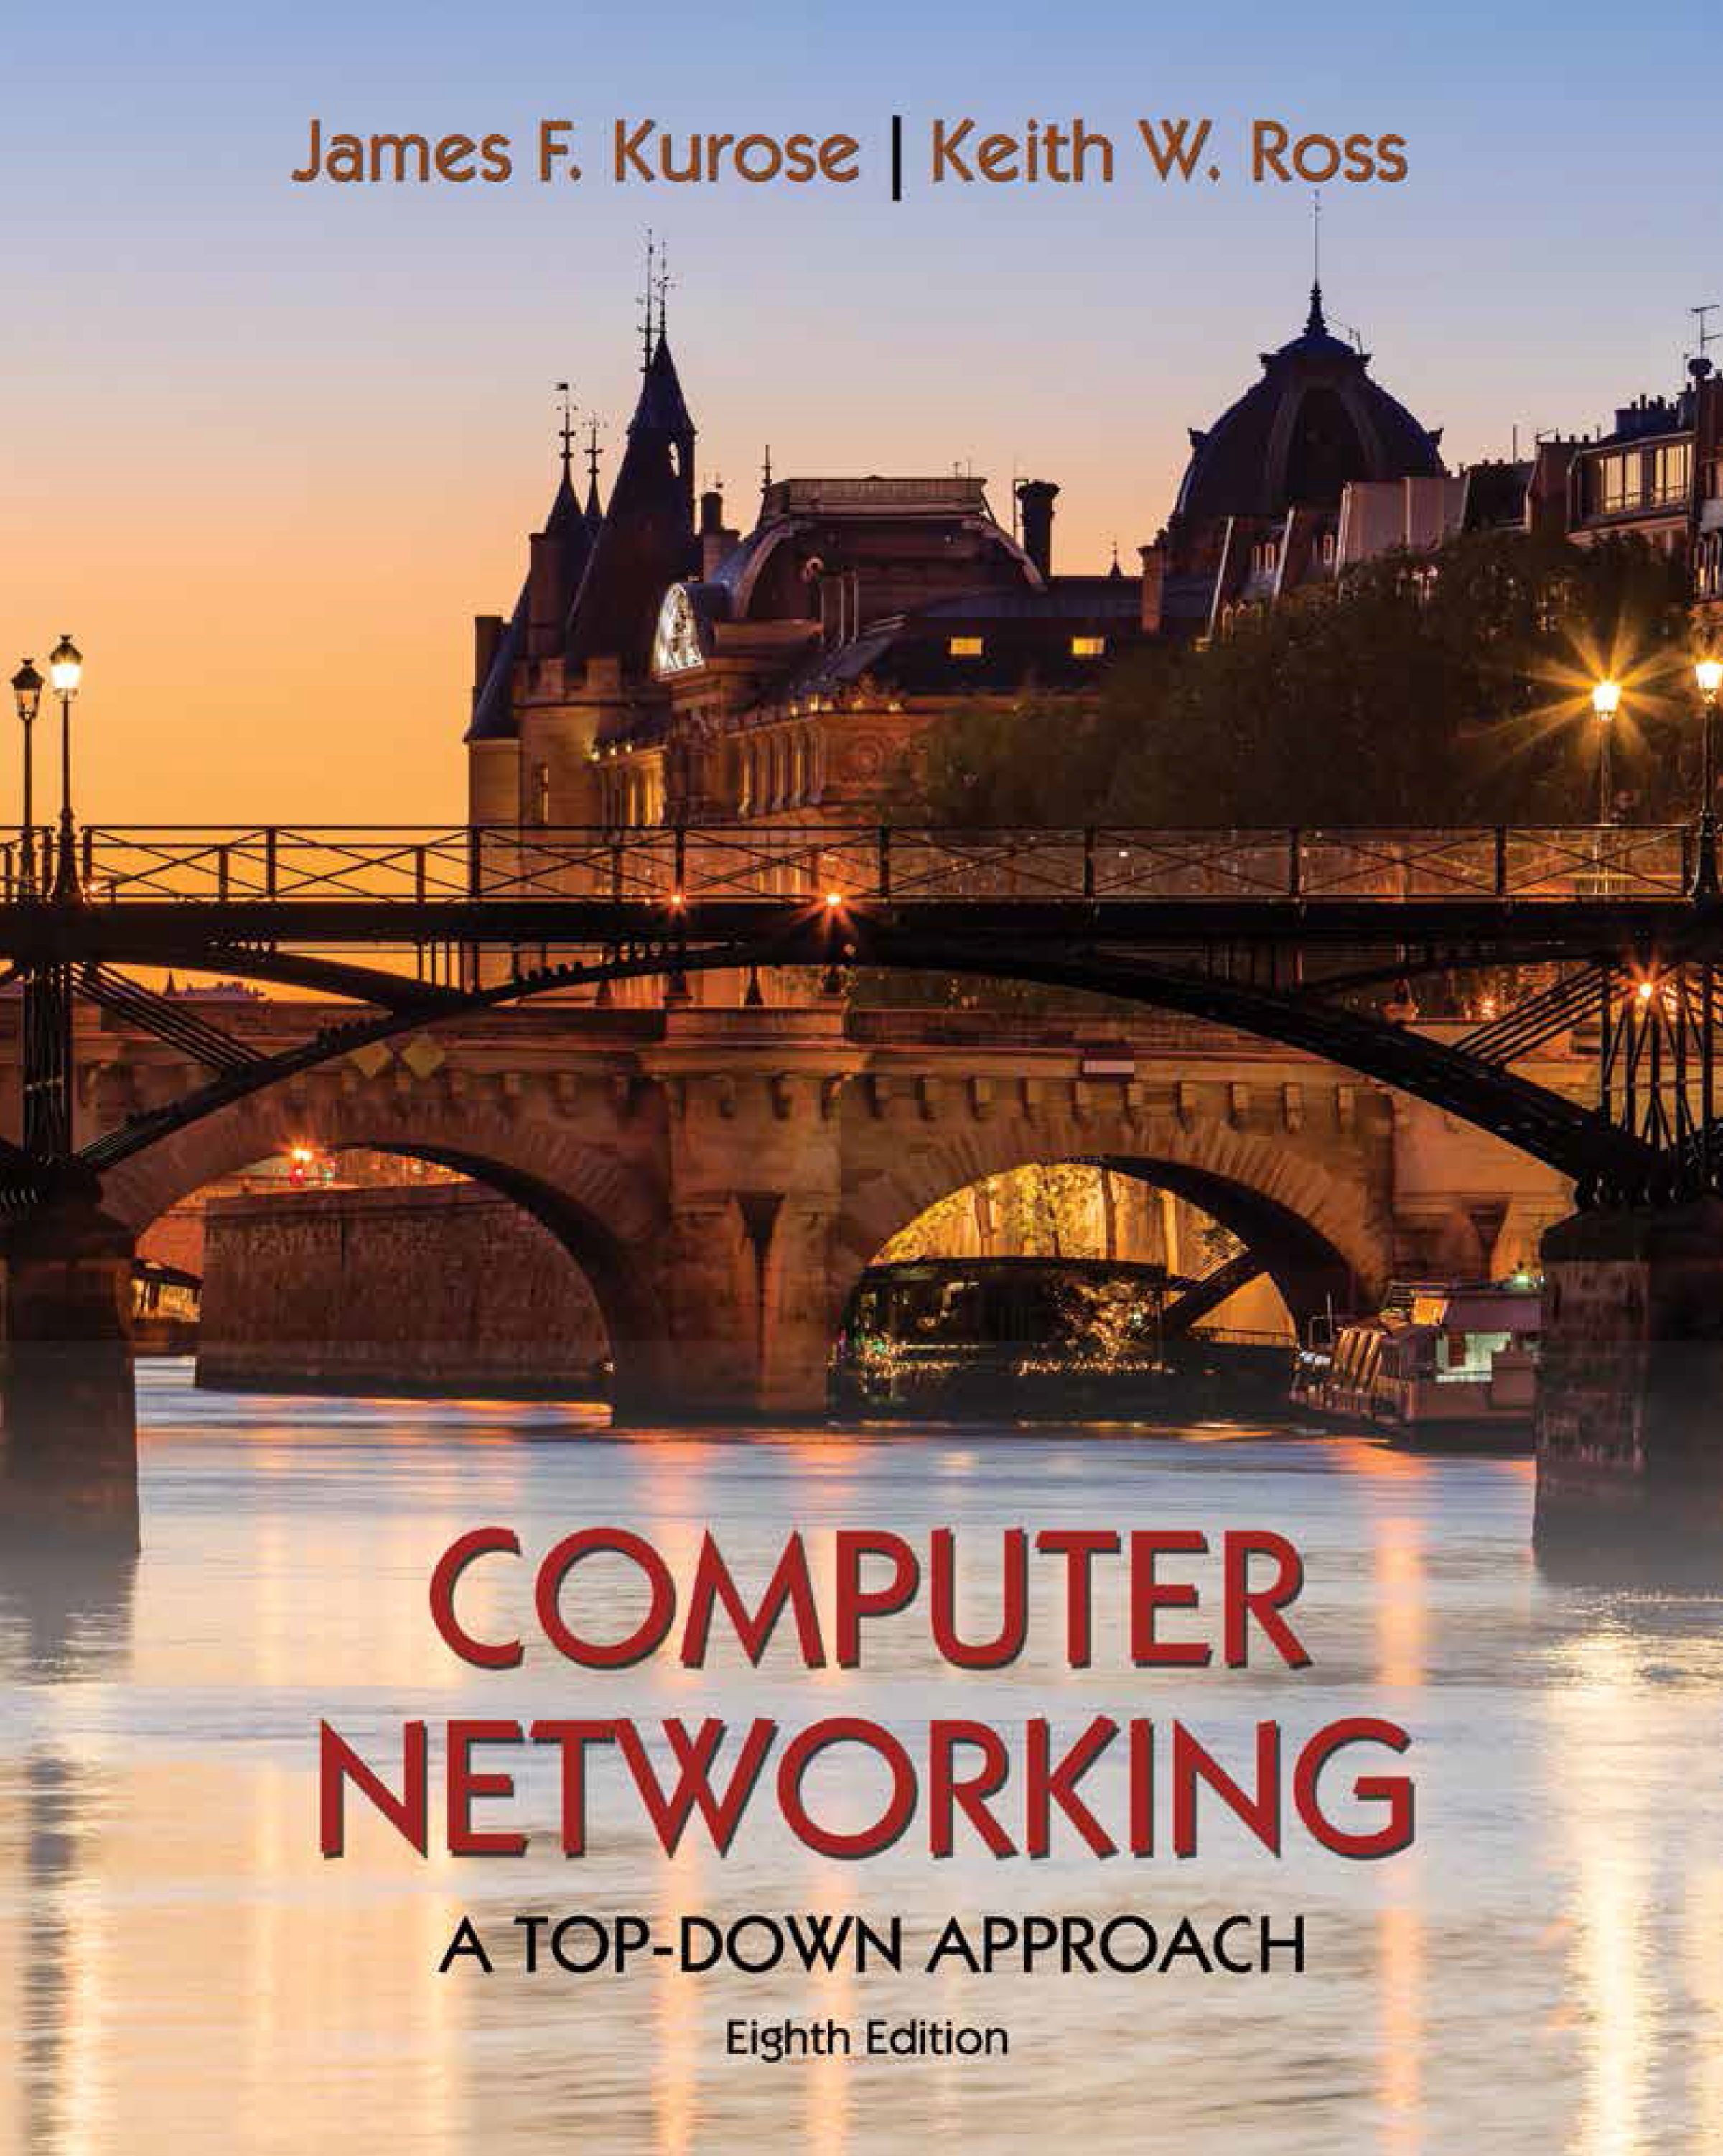
Transport Layer
COMPSCI 453 Computer Networks
Professor Jim Kurose
College of Information and Computer Sciences
University of Massachusetts
Transport-layer services
Multiplexing and demultiplexing
Connectionless transport: UDP
Principles of reliable data transfer
Connection-oriented transport: TCP
Principles of congestion control
TCP congestion control
Evolution of transport-layer functionality
Class textbook:
Computer Networking: A Top-Down Approach (8th ed.)
J.F. Kurose, K.W. Ross
Pearson, 2020
http://gaia.cs.umass.edu/kurose_ross

Slide 2
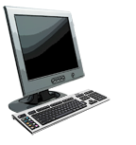
Multiplexing/demultiplexing
multiplexing at sender:
demultiplexing at receiver:
handle data from multiple
sockets, add transport header (later used for demultiplexing)
use header info to deliver
received segments to correct
socket
application
application
P1
P2
application
socket
P3
transport
P4
process
transport
network
transport
network
link
network
link
physical
link
physical
physical

Slide 3




HTTP server
client
application
application
HTTP msg
transport
H_{t}
HTTP msg
H_{n}
H_{t}
network
transport
HTTP msg
transport
network
link
network
link
physical
link
physical
physical

Slide 4
HTTP server
client
application
application
transport
transport
network
transport
network
link
network
link
physical
link
physical
physical
H_{n}
H_{t}
HTTP msg

Slide 5

HTTP server
client₁
client₂
application
P-client₁
P-client₂
application
transport
transport
network
transport
network
link
network
link
physical
link
physical
physical

Slide 6
How demultiplexing works
host receives IP datagrams
each datagram has source IP address, destination IP address
each datagram carries one transport-layer segment
each segment has source, destination port number
host uses IP addresses & port numbers to direct segment to appropriate socket
32 bits
source port #
dest port #
other header fields
application
data
(payload)
TCP/UDP segment format

Slide 7
Connectionless demultiplexing
Recall:
when creating socket, must specify host-local port #:
DatagramSocket mySocket1 = new DatagramSocket(12534);
when receiving host receives UDP segment:
checks destination port # in segment
directs UDP segment to socket with that port #
when creating datagram to send into UDP socket, must specify
destination IP address
destination port #
IP/UDP datagrams with same dest. port #, but different source IP addresses and/or source port numbers will be directed to same socket at receiving host

Slide 8
Connectionless demultiplexing: an example
DatagramSocket serverSocket = new DatagramSocket
(6428);
DatagramSocket mySocket2 = new DatagramSocket
(9157);
DatagramSocket mySocket1 = new DatagramSocket (5775);
application
application
P1
application
P3
P4
transport
transport
network
transport
network
link
network
link
physical
link
physical
physical
source port: 6428
dest port: 9157
source port: ?
dest port: ?
source port: 9157
dest port: 6428
source port: ?
dest port: ?

Slide 9
Connection-oriented demultiplexing
TCP socket identified by 4-tuple:
source IP address
source port number
dest IP address
dest port number
server may support many simultaneous TCP sockets:
each socket identified by its own 4-tuple
each socket associated with a different connecting client
demux: receiver uses all four values (4-tuple) to direct segment to appropriate socket

Slide 10
Connection-oriented demultiplexing: example
application
application
P4
P5
P6
application
P3
P2
P3
transport
transport
network
transport
network
link
network
link
physical
link
physical
server: IP address B
physical
host: IP address A
source IP,port: B,80
dest IP,port: A,9157
host: IP address C
source IP,port: C,5775
dest IP,port: B,80
source IP,port: A,9157
dest IP, port: B,80
source IP,port: C,9157
dest IP,port: B,80
Three segments, all destined to IP address: B,
dest port: 80 are demultiplexed to different sockets

Slide 11
Summary
Multiplexing, demultiplexing: based on segment, datagram header field values
UDP: demultiplexing using destination port number (only)
TCP: demultiplexing using 4-tuple: source and destination IP addresses, and port numbers
Multiplexing/demultiplexing happen at all layers

Slide 12

Transport Layer
COMPSCI 453 Computer Networks
Professor Jim Kurose
College of Information and Computer Sciences
University of Massachusetts
Transport-layer services
Multiplexing and demultiplexing
Connectionless transport: UDP
Principles of reliable data transfer
Connection-oriented transport: TCP
Principles of congestion control
TCP congestion control
Evolution of transport-layer functionality
Class textbook:
Computer Networking: A Top-Down Approach (8th ed.)
J.F. Kurose, K.W. Ross
Pearson, 2020
http://gaia.cs.umass.edu/kurose_ross
Video: 2020, J.F. Kurose, All Rights Reserved
Powerpoint: 1996-2020, J.F. Kurose, K.W. Ross, All Rights Reserved

Slide 13
HTTP server
client
application
application
transport
transport
network
transport
network
link
network
link
physical
link
physical
physical

Slide 14
HTTP server
client
application
application
transport
transport
network
transport
network
link
network
link
physical
link
physical
physical

Slide 15
?
de-multiplexing

Slide 16
application
?
transport
de-multiplexing

Slide 17
multiplexing

Slide 18
application
transport
multiplexing

Slide 19
HTTP server
client₁
client₂
application
P-client₁
P-client₂
application
transport
transport
network
transport
network
link
network
link
physical
link
physical
physical

Slide 20
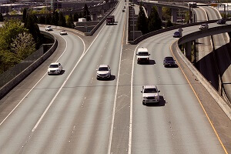
Multiplexing

Slide 21
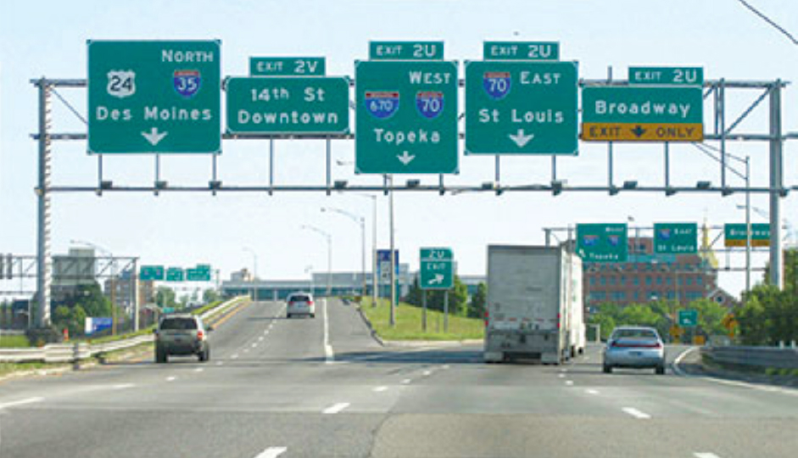
Demultiplexing

Slide 22


Slide 23
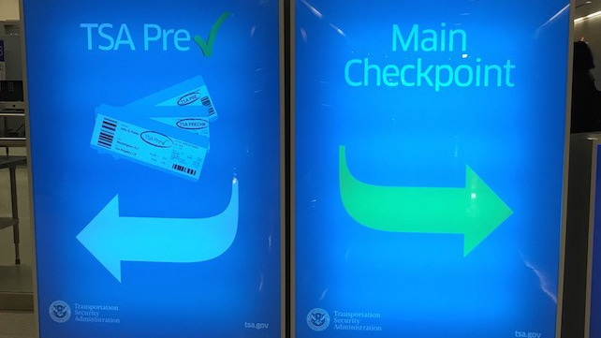

Slide 24
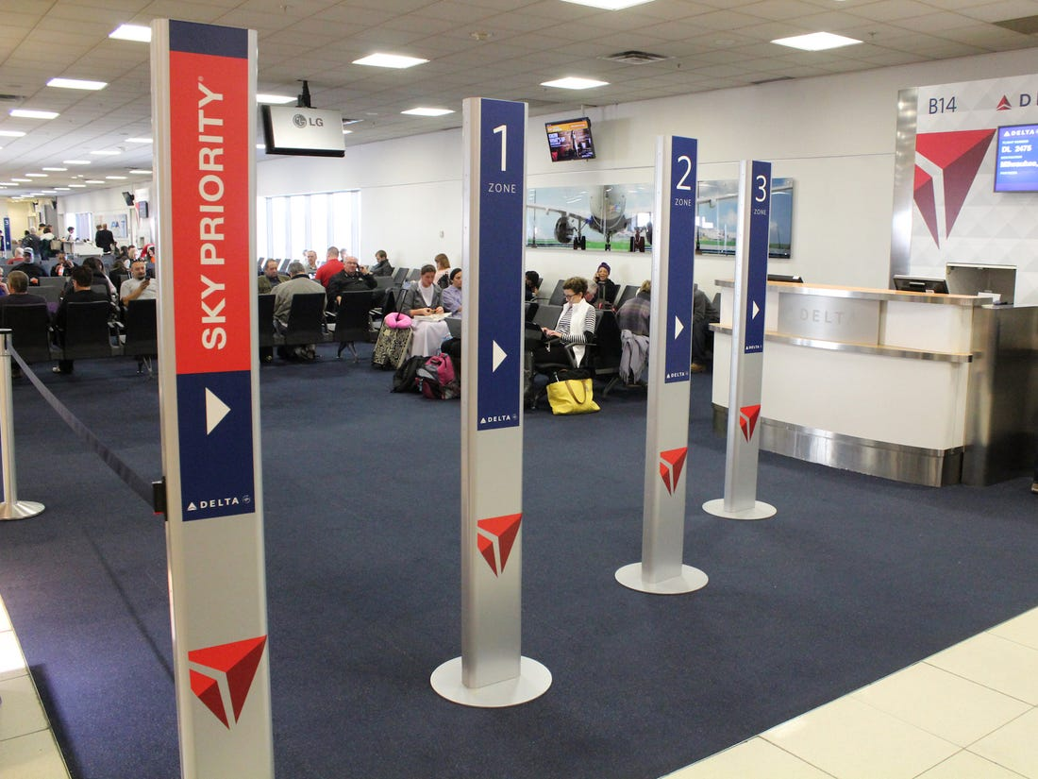

Slide 25
HTTP server
client
application
application
HTTP msg
transport
transport
network
transport
network
link
network
link
physical
link
physical
physical

Slide 26
HTTP server
client
application
application
HTTP msg
transport
H_{t}
HTTP msg
transport
network
transport
network
link
network
link
physical
link
physical
physical

